Slide 1


Slide 2


CASH TO ONLINE AND ONLINE TO CASH
Second Year Project Synopsis
Submitted by
ROLL | NAME
2301010196 | Shubham Sarkar
2301010197 | Mohit Rathi
2301010198 | Ankit
2301010200 | Amandeep
Industry Mentor: Mr. Rohit
Faculty Mentor: Mr. Rupesh Tipu
Notes:
New Courses replaced with New Programmes

Slide 3

Project Overview
The Cash-to-Online and Online-to-Cash Exchange System is a digital platform (website/app) designed to help users exchange physical cash for digital money and vice versa. It connects individuals who need to convert their cash into online funds (such as UPI, Paytm, or bank transfers) with others who need cash in exchange for their digital balance. In today’s digital world, cash and online transactions coexist, but users often face difficulties when they need cash but only have an online balance or vice versa. This system provides a structured, reliable, and secure platform to help users perform these exchanges efficiently.
Notes:
New Courses replaced with New Programmes

Slide 4
About the Problem
Limited availability of ATMs or high withdrawal charges.
Difficulty in accessing cash in emergency situations.
Unavailability of online payment methods in some areas or businesses.
Risk of fraud when exchanging money informally.
Lack of user trust due to the absence of verification systems.
Notes:
New Courses replaced with New Programmes

Slide 5
Problem Statement
Define the problem clearly
There is no structured, secure, and reliable way for individuals to exchange physical cash for digital money or vice versa. People often rely on unverified sources, leading to risks of fraud and inconvenience.
Why is it important?
Helps users find quick and easy cash or digital transactions.
Reduces dependency on ATMs and banks.
Provides a safe and trusted medium for money exchanges.
Expected Impact of Solving This Problem
Secure and efficient transactions.
Helps small businesses and individuals who frequently deal with cash-based transactions.
Reduces cash scarcity problems in emergency situations.
Notes:
New Courses replaced with New Programmes

Slide 6
Objectives
The main goal of this project is to develop a secure, location-based cash and online money exchange platform that enables verified users to perform transactions easily.
Specific Objectives:
Develop a user-friendly web and mobile application.
Implement a location-based matching system to connect nearby users.
Ensure secure transactions through user verification and transaction tracking.
Provide a review and rating system to maintain trust among users.
Notes:
New Courses replaced with New Programmes

Slide 7
Methodology, Tools, and Techniques
Approach Taken to Solve the Problem
User Registration & Verification – Users will sign up and verify their identity for secure exchanges.
Location-based Matching – System will locate nearby users available for transactions.
Transaction Execution – Users can initiate transactions and confirm exchanges.
Feedback & Security Measures – Ratings, transaction history, and dispute resolution system.
Tools, Software, and Techniques Used
Frontend: HTML, CSS, JavaScript (React.js)
Backend: Python (Django/Flask) or Node.js
Database: MySQL or Firebase
Payment Integration: UPI, Paytm API, Razorpay
Geolocation Services: Google Maps API for location-based transactions
Security: OTP-based verification, encryption for transactions
Justification for Chosen Methods
React.js – For a dynamic and responsive user interface.
Django/Flask – Secure and scalable backend framework.
Google Maps API – Ensures accurate user location-based matching.a
Notes:
New Courses replaced with New Programmes

Slide 8
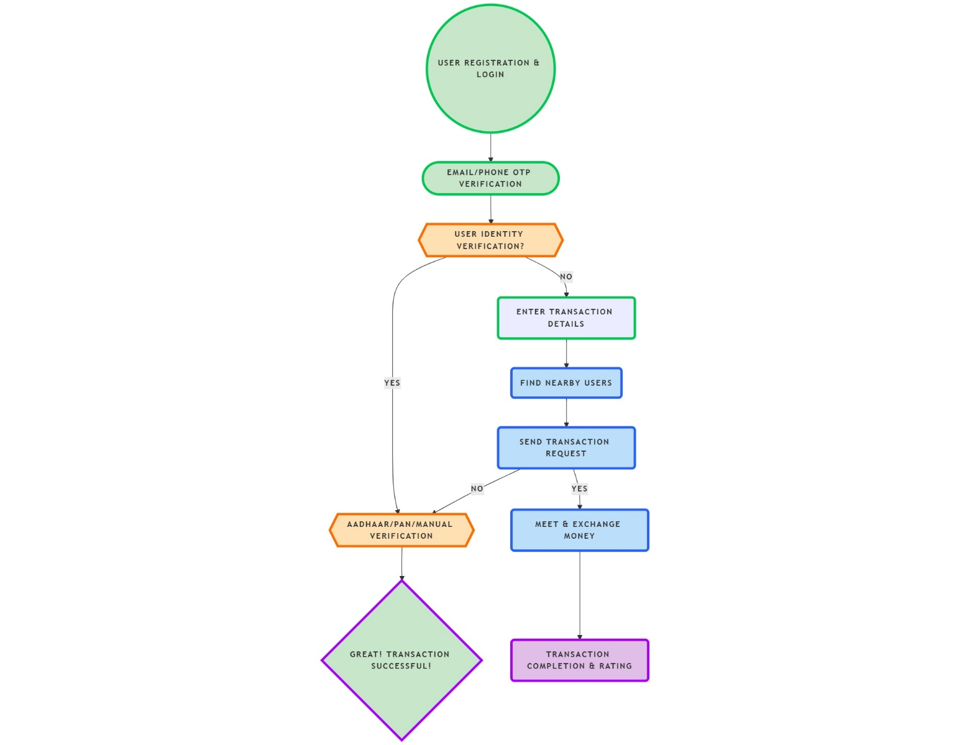
Methodology Flowchart
Notes:
New Courses replaced with New Programmes

Slide 9
Project Timeline
Phase | Task | Duration
Phase 1 | Research & Requirement Analysis | 2 Weeks
Phase 2 | UI/UX Design & Wireframing | 3 Weeks
Phase 3 | Backend Development & Database Setup | 4 Weeks
Phase 4 | Frontend Development & API Integration | 4 Weeks
Phase 5 | Testing & Debugging | 3 Weeks
Phase 6 | Deployment & User Testing | 2 Weeks
Phase 7 | Final Documentation & Report | 2 Weeks
Notes:
New Courses replaced with New Programmes

Slide 10
Expected Results & Impact
Expected Results
A working web and mobile-based platform for cash-to-online and online-to-cash exchanges.
Secure user verification system to prevent fraud.
Efficient location-based matching to find nearby users.
Seamless payment and transaction system with real-time updates.
Impact
Convenience – Helps users quickly find cash or online money when needed.
Security – Reduces fraud and unregulated cash transfers.
Financial Inclusion – Supports people in areas with limited ATM access.
Future Scope & Possible Extensions
AI-based fraud detection.
Expanding to international money exchange.
Partnership with local businesses for cash transactions.
Notes:
New Courses replaced with New Programmes

Slide 11
References
Research papers, books, and websites related to digital payment systems, peer-to-peer money transfer security, and geolocation-based applications.
API documentation for Google Maps, Razorpay, Paytm, and UPI payment gateways.
Notes:
New Courses replaced with New Programmes

Slide 12
THANK YOU

